Slide 1
CS 319
ITERATION 1
DEMO PRESENTATION
RUSH HOUR
Prepared by
Kaan Gönç
Deniz Dalkılıç
Ahmet Ayrancıoğlu
Ali Yümsel
Sina Şahan

Slide 2
What kind of game is Rush Hour?
Rush Hour is a sliding block logic game. It provides a fun way to improve one’s problem solving, sequential thinking and logical reasoning skills by associating it with many people’s real life struggle, the “Traffic”. In real life there are several different versions of the game Rush Hour, which include different scaled maps and vehicle packs. Our game will be based on the original Rush Hour game, however with our own additions and special features to make the players have a better experience in virtual life when compared to playing the game in real life.

Slide 3
Overview

Slide 4
Overview
The Rush Hour game consists of
6x6 playing board
An exit on the right edge
An escape car
Different sized vehicles which are used as obstacles preventing the player's car to move on the board
40 different levels

Slide 5
Overview
The main goal in the game is to lead the red car to the exit by moving the other vehicles on the map out of the way. In order to do that the player must think strategically and move the vehicles to necessary directions.
In terms of the gameplay, players will use a mouse click to choose a vehicle on the map, and the “W”, “A”, “S”, ”D” keys to move the chosen vehicle through the grids.
The vehicles will display a smooth animation during their sequence between the grids.

Slide 6
Overview
During the gameplay, the player will be able to pause or exit
Autosaving that saves the level progress special for the active player each time a vehicle is moved
The game will keep a track of the number of moves the player did during a level

Slide 7
Features in addition to board game
Bonus Mode
Reward system
Sound System

Slide 8
Use Case Diagram

Slide 9
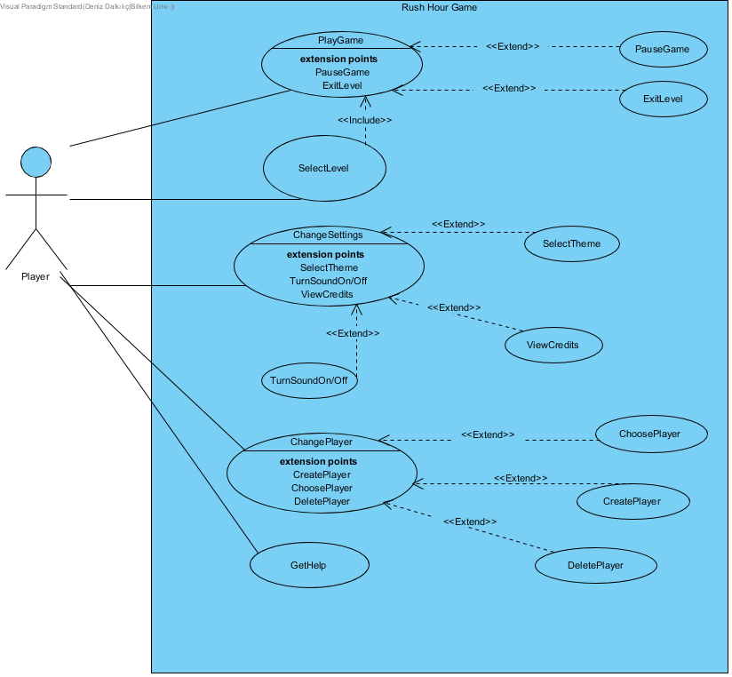

Slide 10
Non-Functional Requirements

Slide 11
Supportability
Extendible design
Maintainable structure
Object oriented design concepts

Slide 12
Usability
Understandability of the main features
Easily interactable user interface
Attractive user interface design
No unnecessary information
Ability to get help when necessary
Feelings of the metaphors of the real world

Slide 13
Reliability
Storing multiple player profiles
Crash protected
Autosaving the progress
Local backup system

Slide 14
Performance
Smooth animations
Ability to define each input separately in the same frame
Fast progress saving
Fluent transition between panels

Slide 15
Classic Mode Sequence Diagram

Slide 16
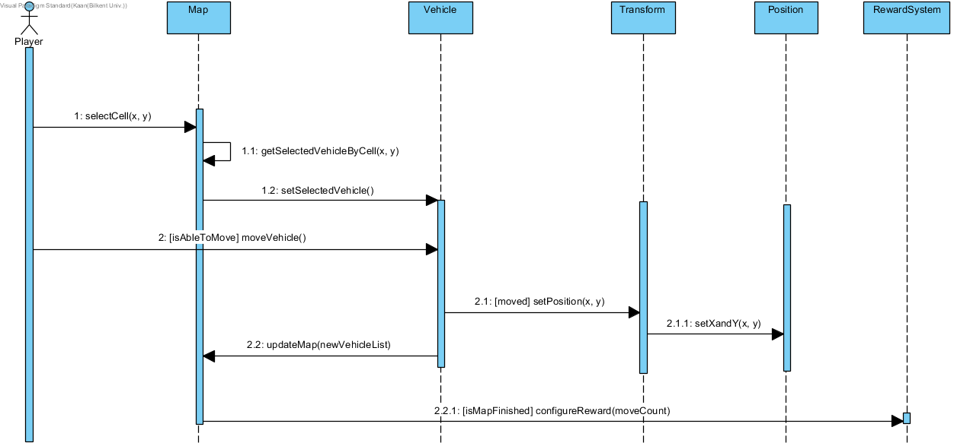

Slide 17
Bonus Mode Sequence Diagram

Slide 18
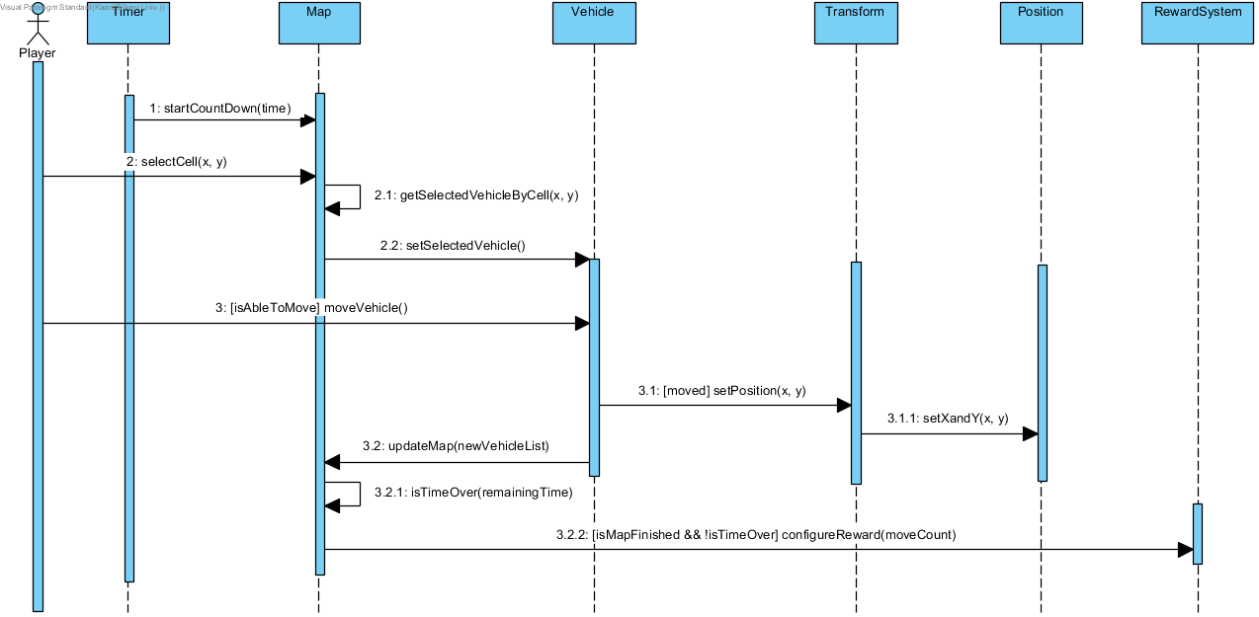

Slide 19
Activity Diagram

Slide 20
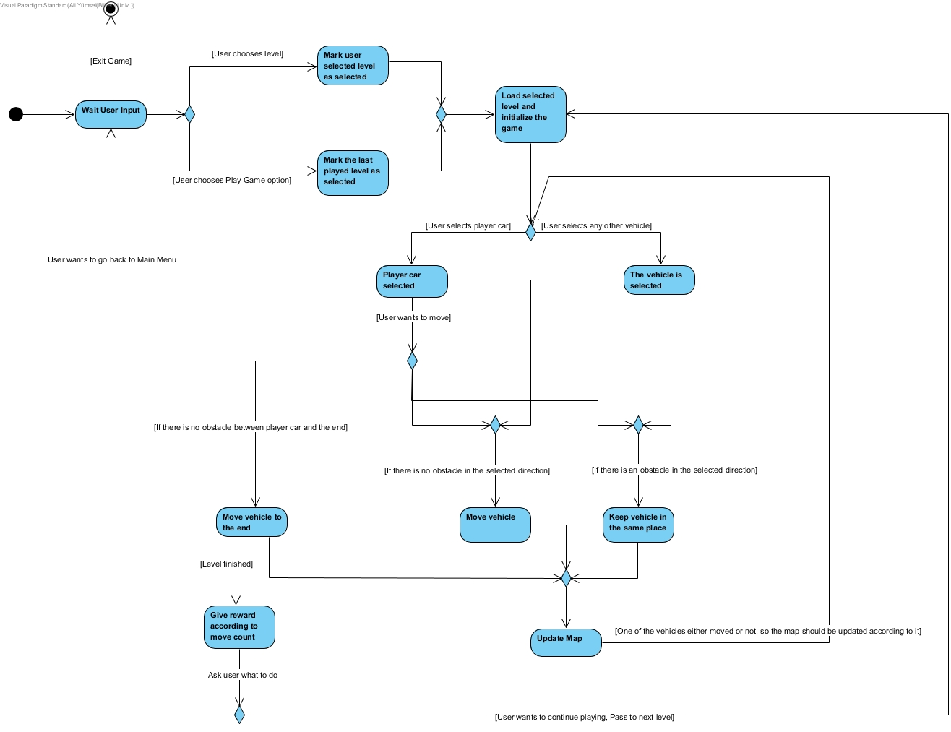

Slide 21
State Diagram

Slide 22
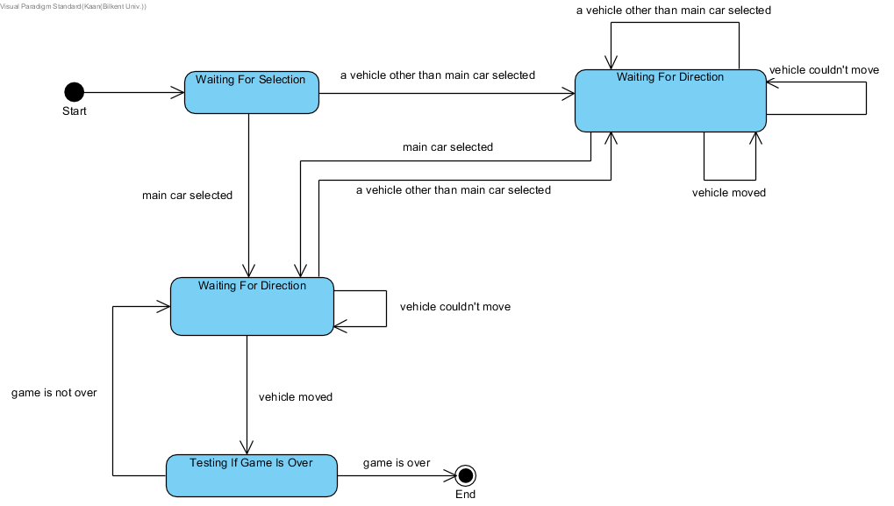

Slide 23
Object Model

Slide 24
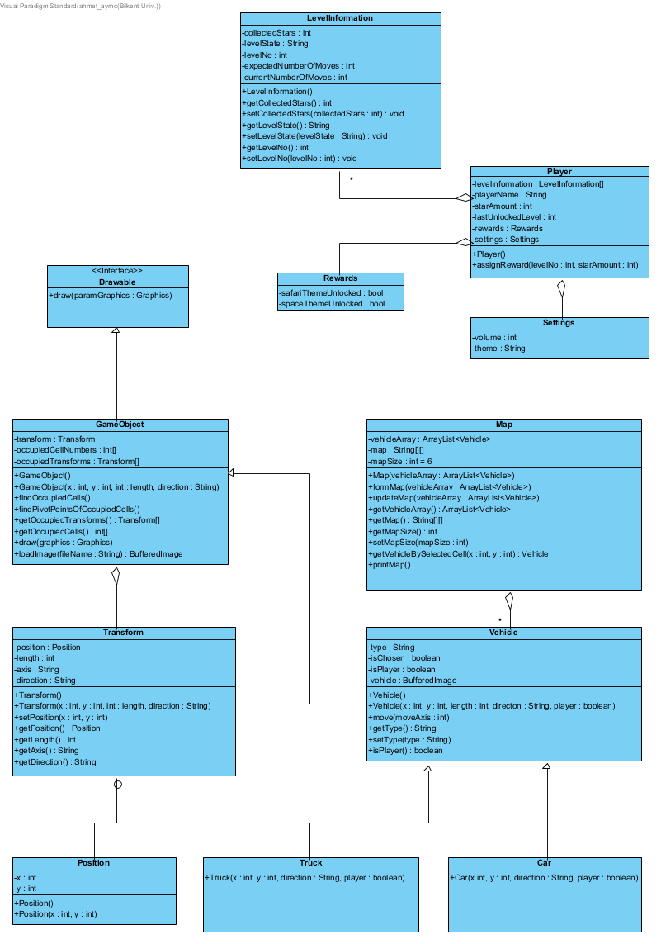

Slide 25
Subsystem Decomposition

Slide 26
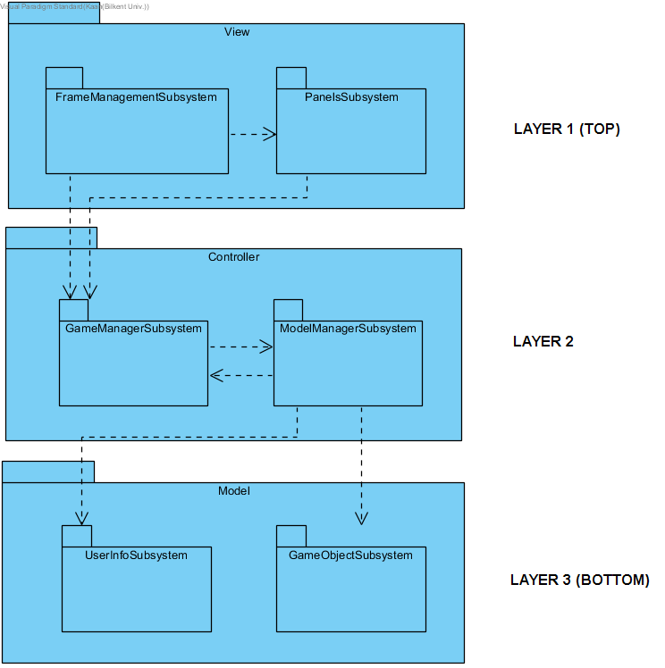

Slide 27
Class Diagram (Model-Controller)

Slide 28
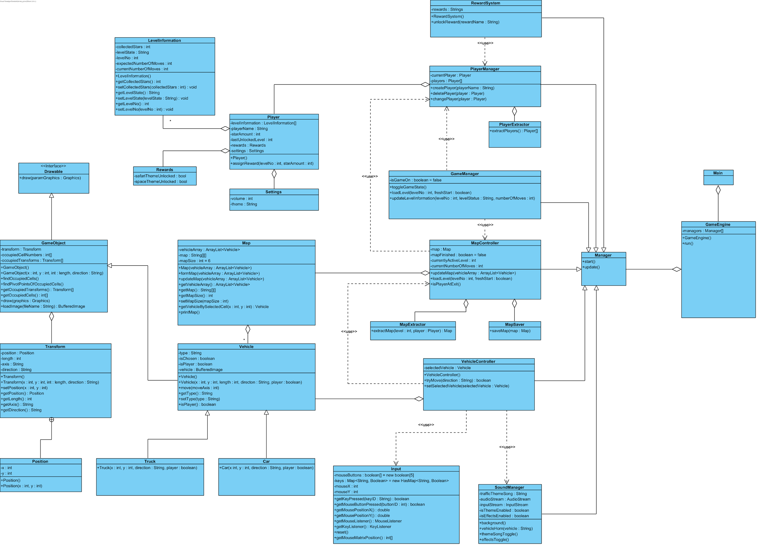

Slide 29
Class Diagram
(View)

Slide 30
